Slide 1


Department of BES-1
DATA STRUCTURE
24SC1203
Topic:
AVL TREE implementation(insertion)
Session – 30

Slide 2



AIM OF THE SESSION
To familiarize students with the basic concept of AVL tree and its operations
INSTRUCTIONAL OBJECTIVES
This Session is designed to:
Demonstrate AVL Tree creation, insertion and deletion.
Describe the AVL Tree and its implementations.
List out the rotations perform on AVL Tree.
Describe the balance factor.
LEARNING OUTCOMES
At the end of this session, you should be able to:
Define AVL Tree and Balance factor.
Describe the operation on AVL Tree.
Summarize the creation, insertion and deletion with examples.

Slide 3
SESSION INTRODUCTION
AVL Tree
The AVL tree name comes from Adelson – Velskii and Landis.
The AVL tree is Self-balanced binary search tree.
AVL tree is defined as height balanced binary search tree in which each node is associated with a balance factor which is calculated by subtracting the height of its right sub-tree from that of its left sub-tree.

Slide 4
SESSION DESCRIPTION (Cont..)
AVL Tree Insertion operation & Algorithm
Insertion in AVL tree is performed as in a binary search tree. However, it may lead to violation in the AVL tree property and therefore the tree may need balancing. The tree can be balanced by applying rotations.
Step 1: Insert the node in the AVL tree using the same insertion algorithm of BST.
Step 2: Once the node is added, the balance factor of each node is updated.
Balance factor = height of left subtree - height of right subtree.
Step 3: Now check if any node violates the range of the balance factor if the balance factor is violated, then perform rotations using the above case.

Slide 5
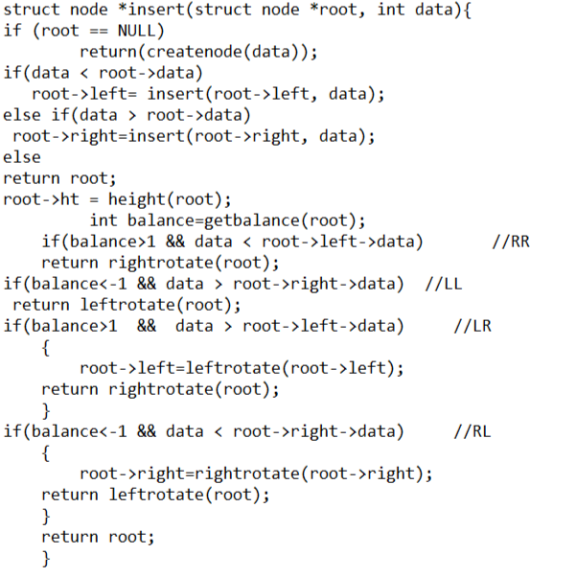
Implementation for insertion

Slide 6


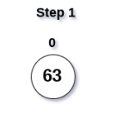
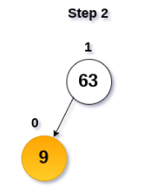
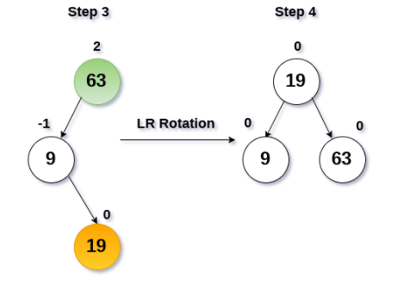
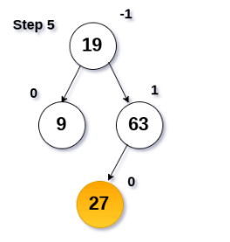
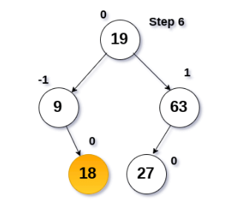
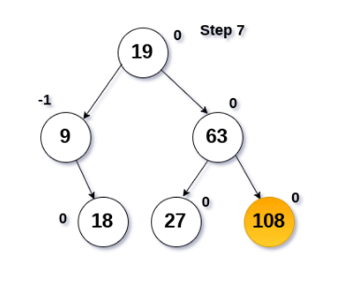
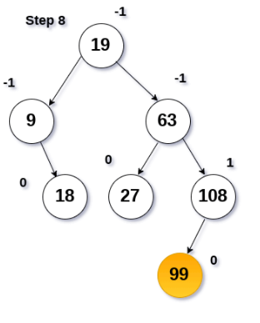
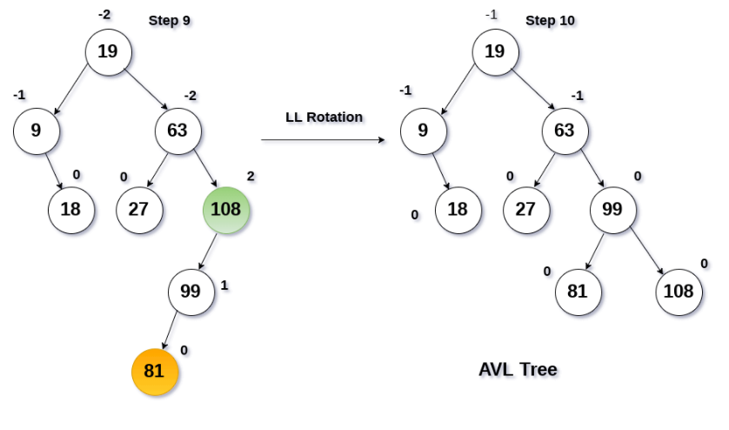
EXAMPLES
Construct an AVL tree by inserting the following elements in the given order.
63, 9, 19, 27, 18, 108, 99, 81

Slide 7
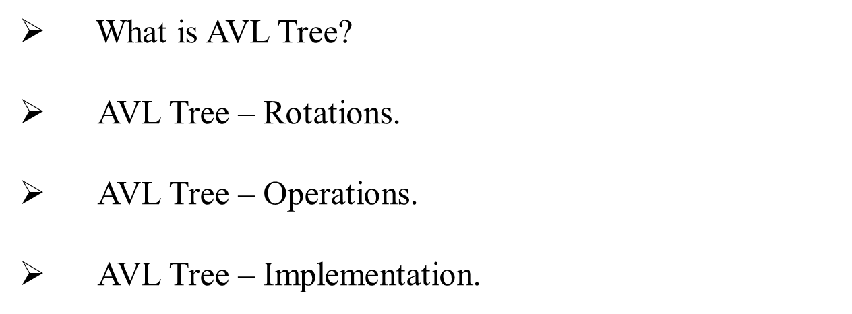
SUMMARY

Slide 8
SELF - ASSESSMENT QUESTIONS
Why we need to a binary tree which is height balanced?
a) to avoid formation of skew trees
b) to save memory
c) to attain faster memory access
d) to simplify storing
Which of the following rotations is called a double rotation in AVL Tree?
a) RL and RR
b) LR and RL
c) LL and RR
d) More than one of the above.
e) None of the above.

Slide 9
TERMINAL QUESTIONS
1. Describe the AVL Tree and Balance Factor?
2. List out the rotations perform on AVL Tree?
3. Analyze the implementation of AVL Tree?
4. Summarize the creation, insertion and deletion operations in AVL Tree?

Slide 10
REFERENCES FOR FURTHER LEARNING OF THE SESSION
Reference Books:
1. A.V.Aho, J. E. Hopcroft, and J. D. Ullman, “Data Structures And Algorithms”, Pearson Education, First Edition Reprint2003.
2. Horowitz, Sahni, Anderson Freed, “Fundamentals of data structures in C” , Second Edition-2007.
3. R. F. Gilberg, B. A. Forouzan, “Data Structures”, Second Edition, Thomson India Edition, 2005
Sites and Web links:
https://nptel.ac.in/courses/106101060/4
https://www.edx.org/course/algorithms-and-data-structures-12.
3. https://practicepaper.in/gate-cse/avl-tree

Slide 11
THANK YOU
BES-1 – Data Structure

